Slide 1
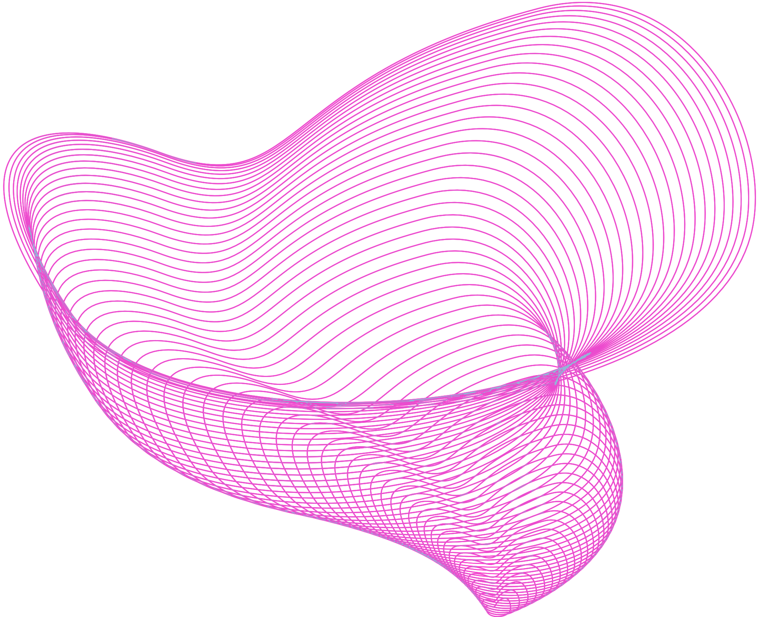
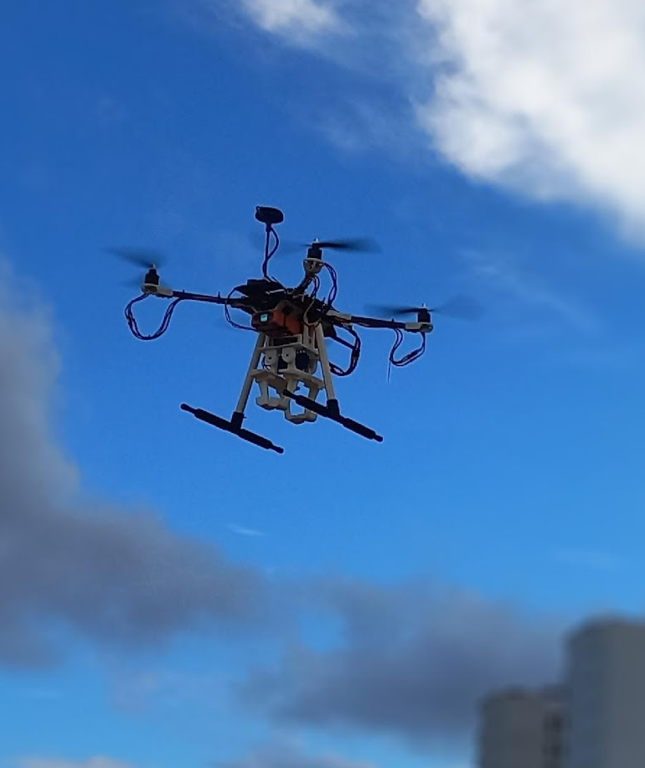
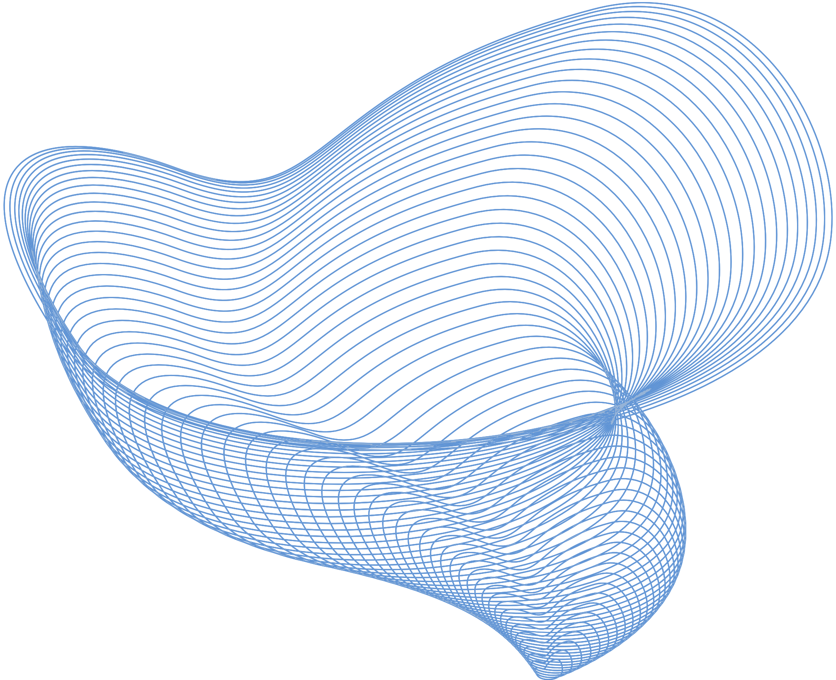

Team Astra
Aerobotics Team

Slide 2



About Us
A dynamic and multidisciplinary team of students building UAVs. A Team under SAE Club of IIITDM Kancheepuram
Lets explore the world of aerial robotics …

Slide 3
Vision
To explore and develop advance technologies in field of Aerial Robotics which includes UAVs, Fixed Wings etc.

Slide 4
Competitions

Slide 5
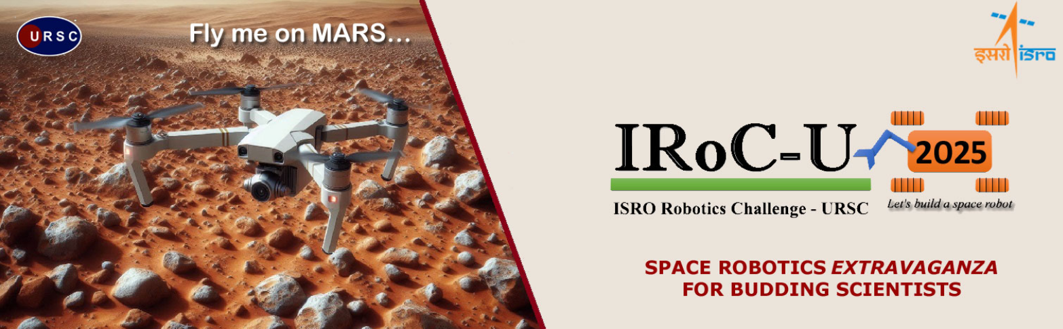
ISRO Robotics Challenge 2025

Slide 6
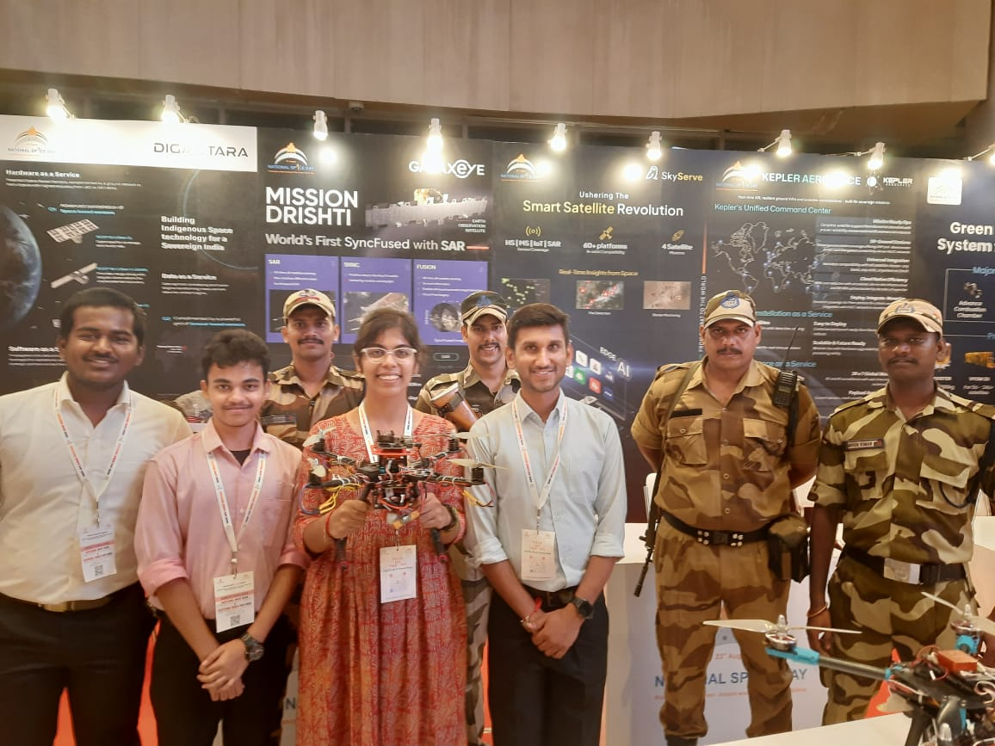
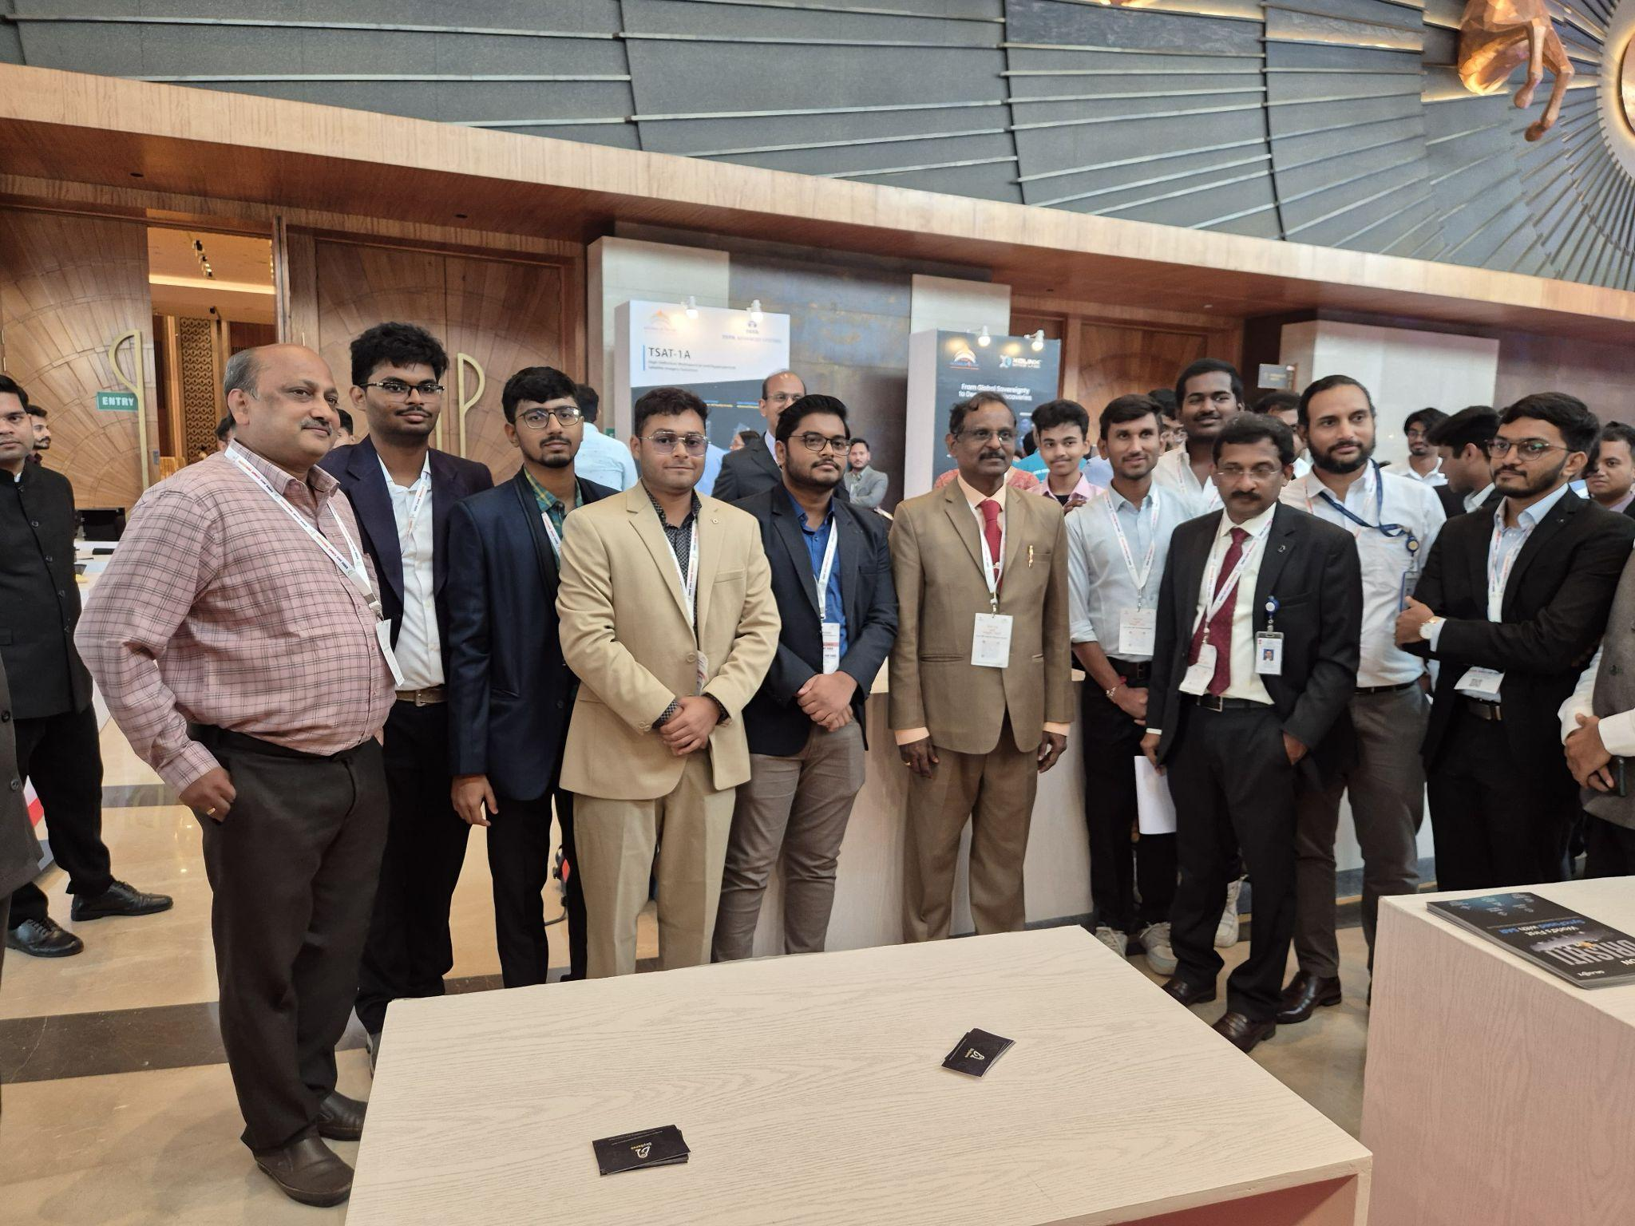
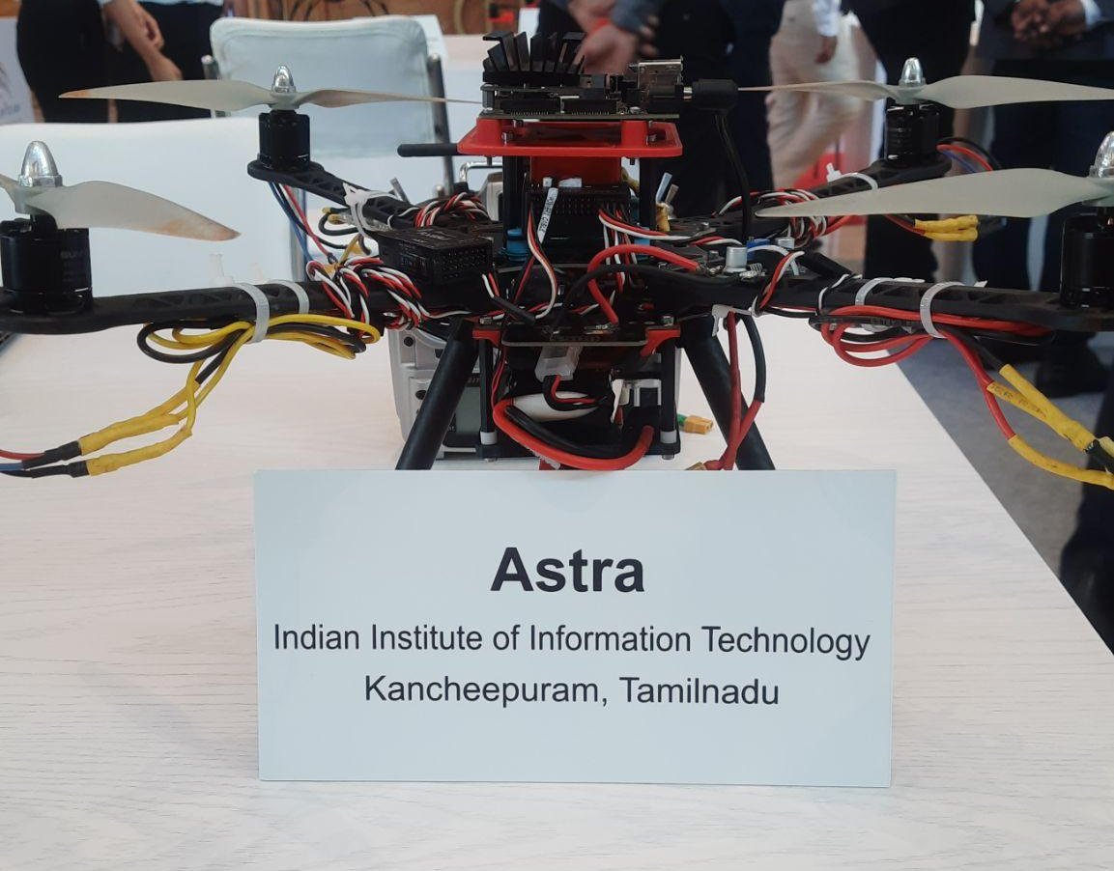
ISRO Robotics Challenge 2025

Slide 7
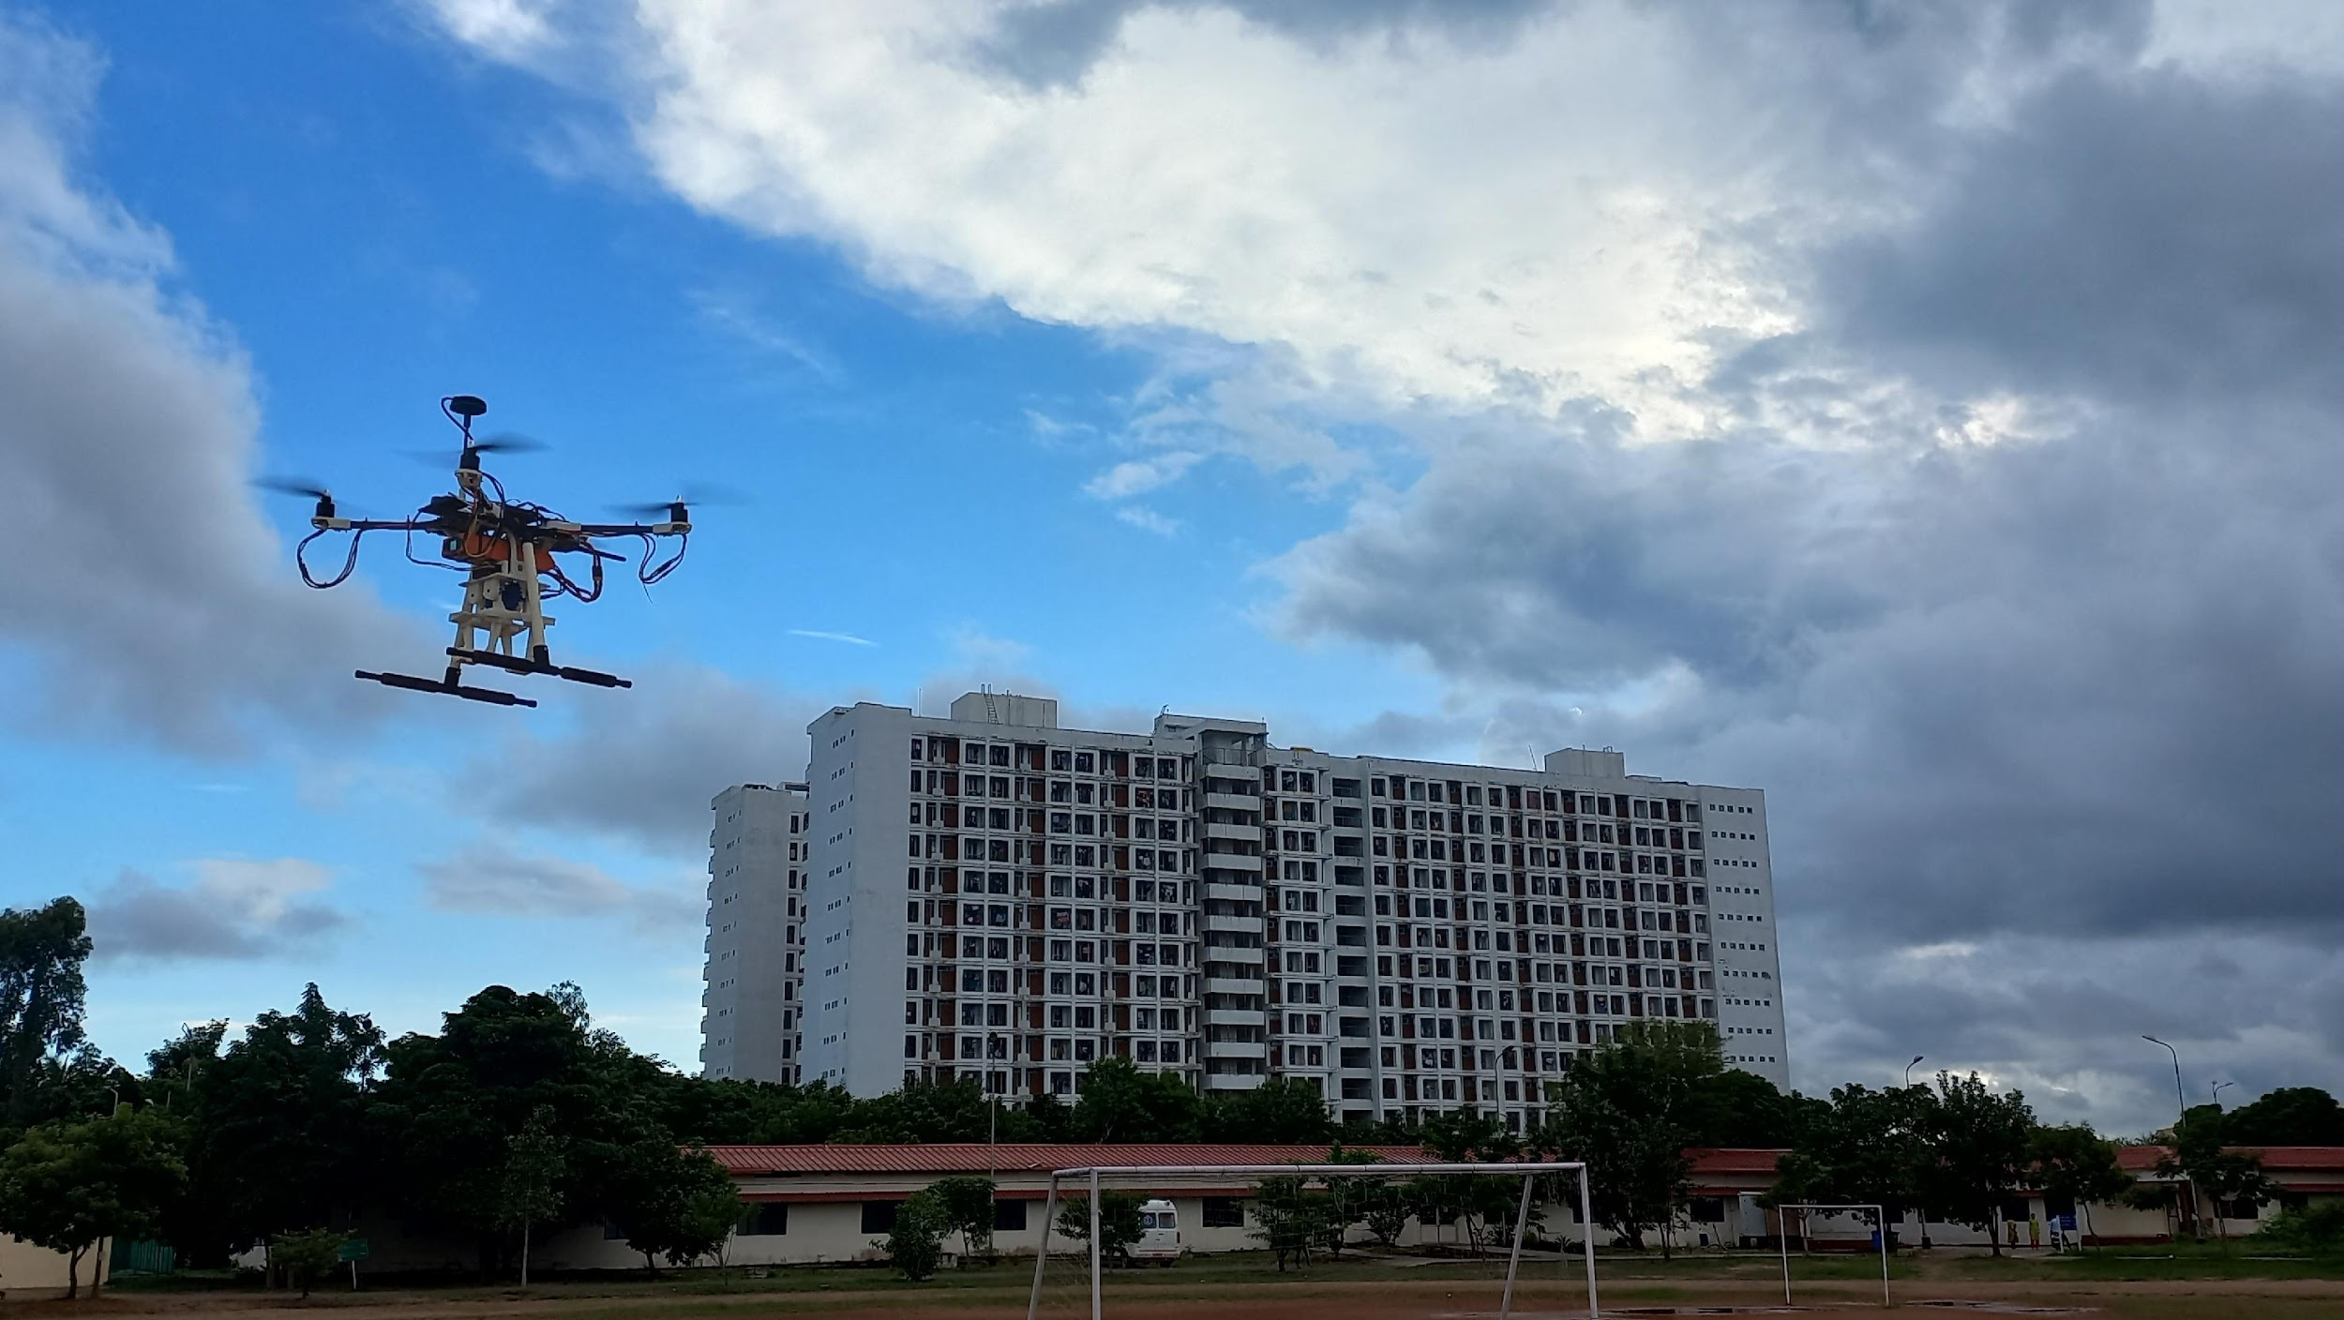


Slide 8
Our Achievements

Slide 9
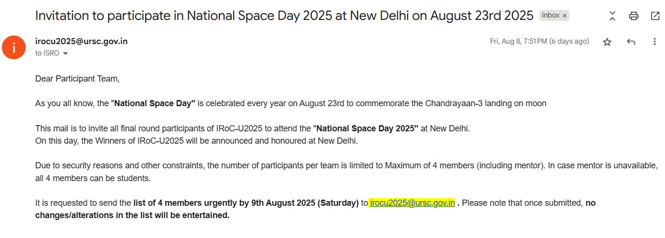
ISRO Robotics Challenge 2025
Our journey in the ISRO Robotics Challenge, where,
Total registrations: 510 teams
Preliminary Round: 222 teams selected
Qualification Round: 177 teams advanced
Elimination Round: 37 teams remained
Final Round at ISRO Headquarters, Bengaluru: Only 16 top teams qualified — including ours

Slide 10
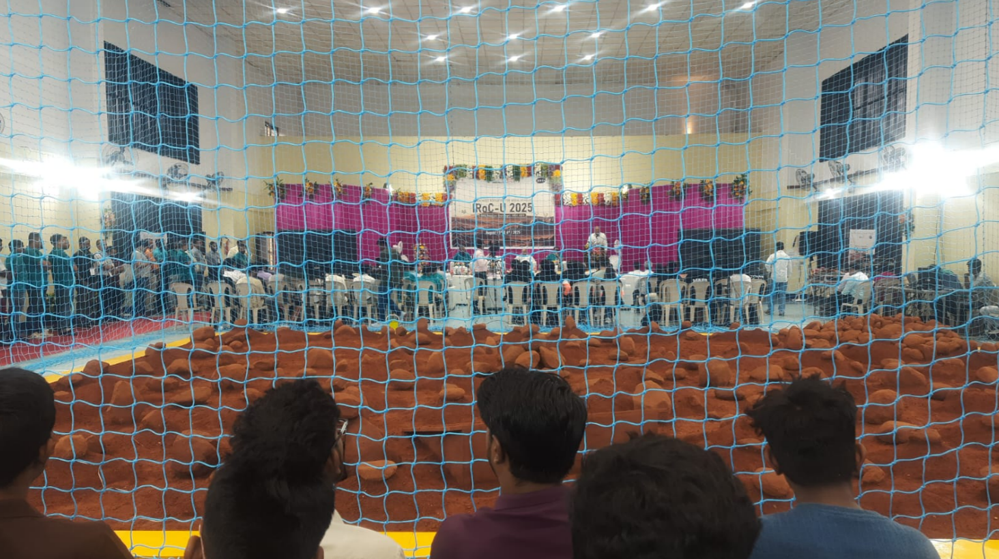
Final Round on 5th August 2025 on Bangalore Onsite

Slide 11
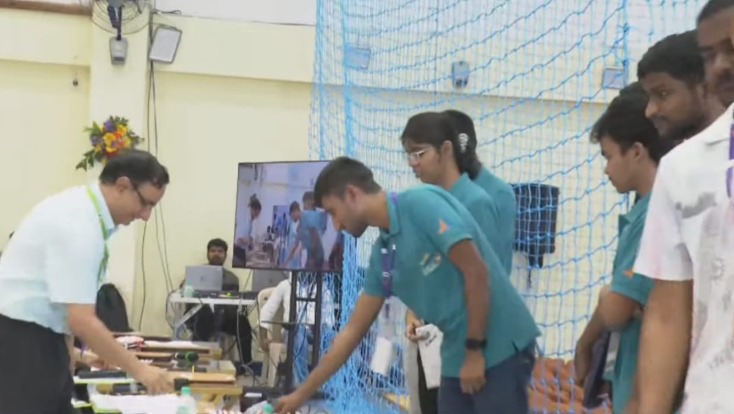
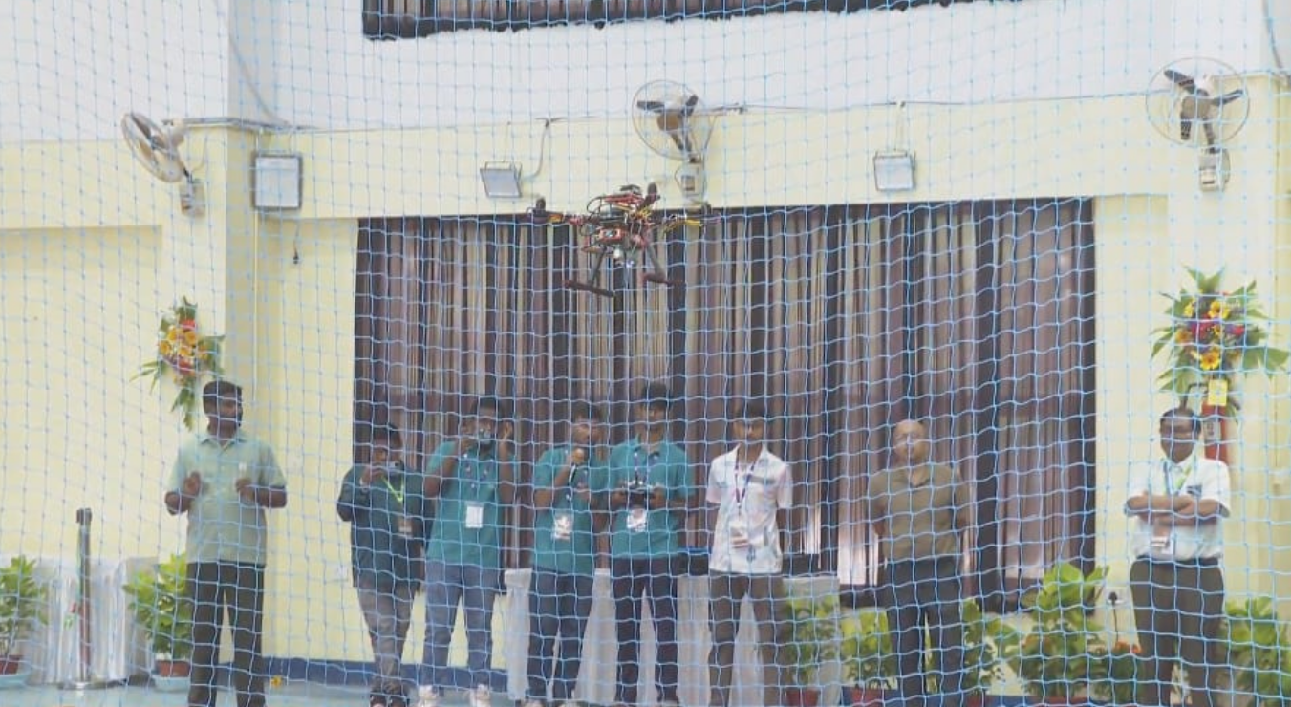
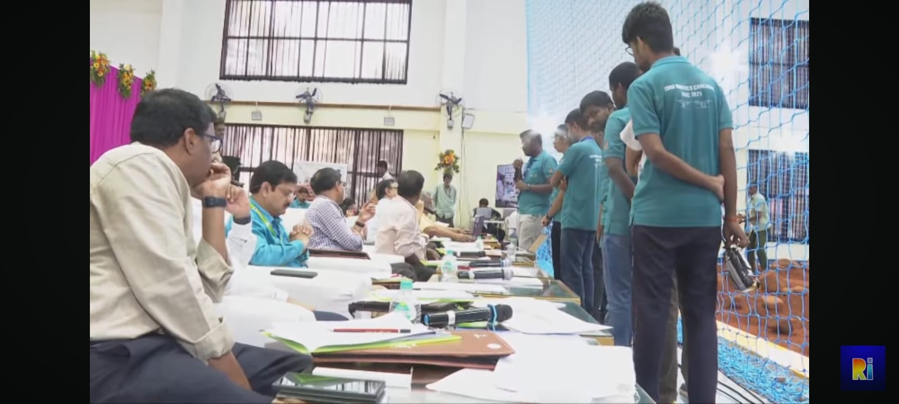
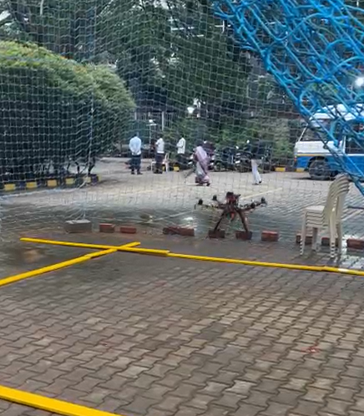
Final Round on 5th August 2025 on Bangalore Onsite

Slide 12
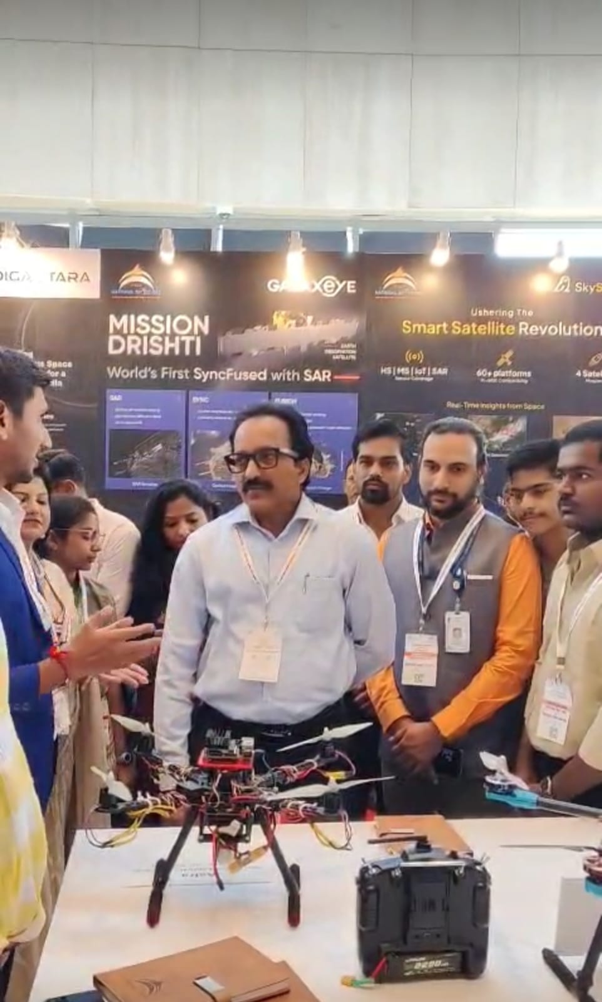
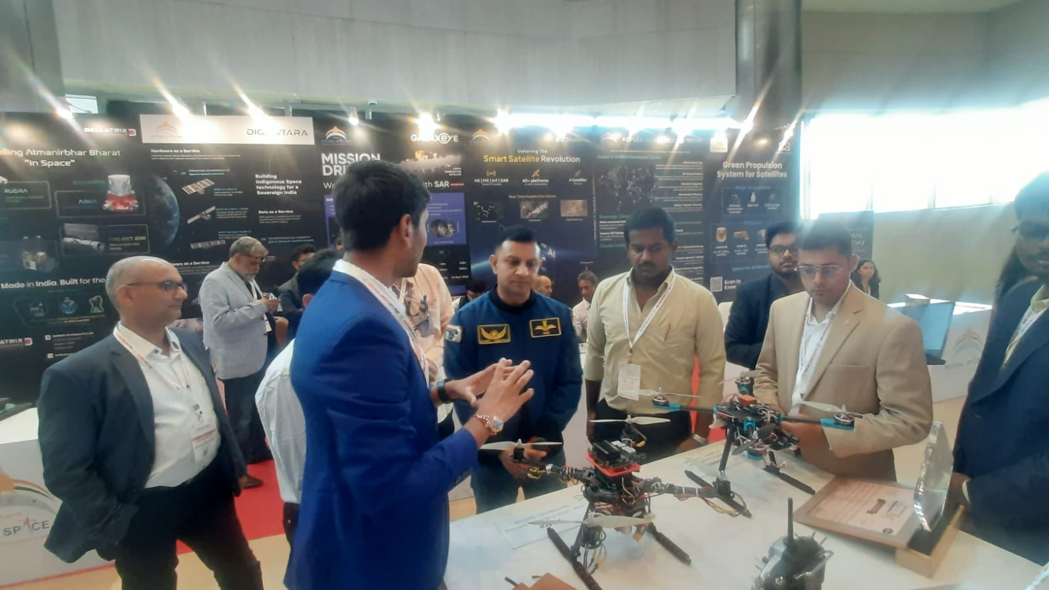
Invitation to attend National Space Day 2025 at New Delhi
Group Commander Angad Pratap one of the 4 Astronauts who selected for Gagaanyan Mission
ISRO former Chairman S.Somanath
(During his leadership , Chandrayan -03
Soft landing on South pole of the Moon, Aditya ,L1 Mission ,Gaganyan mission )

Slide 13
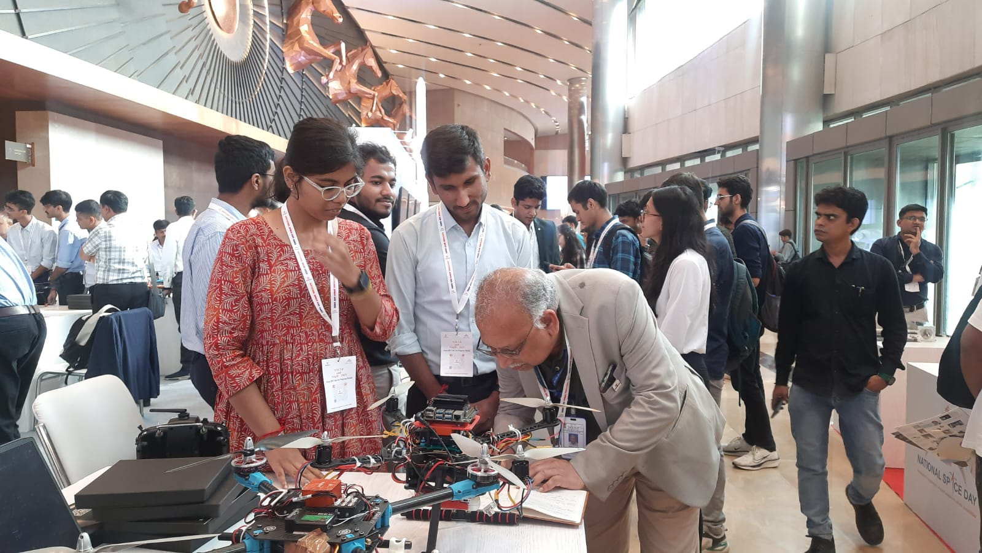
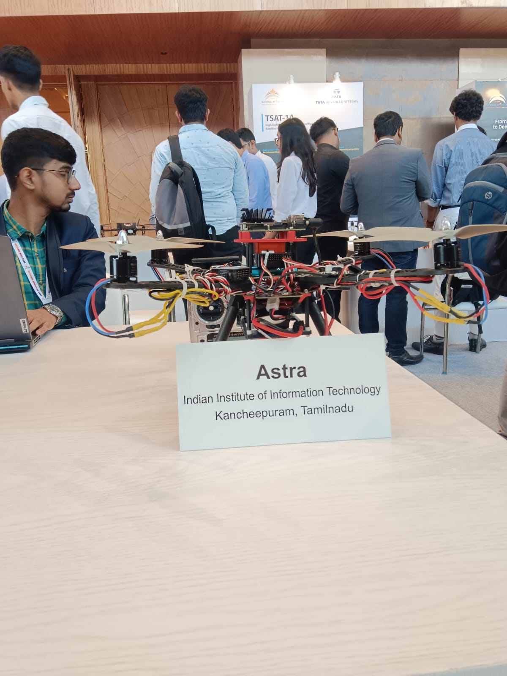
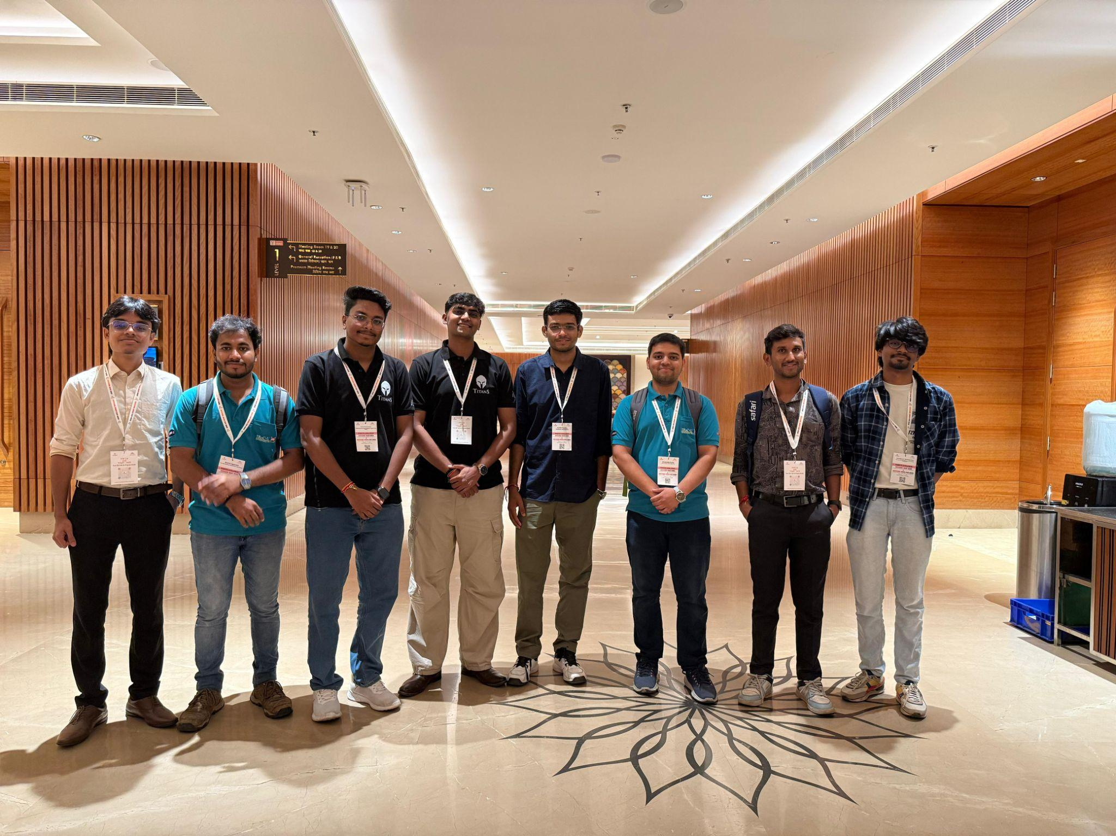
Invitation to attend National Space Day 2025 at New Delhi

Slide 14
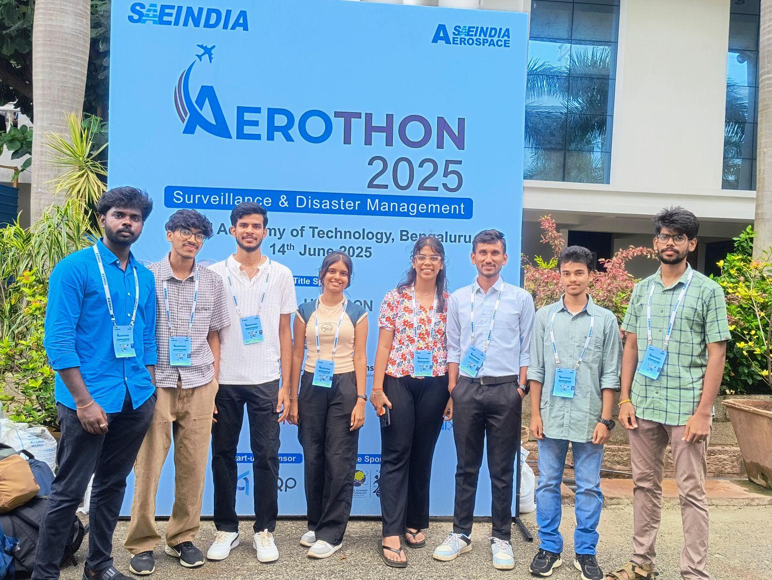
SAE Aerothon 2025 :
Phase 1
Design Report Submission
Secured AIR 8 in Phase 1 Design Report Presentation

Slide 15
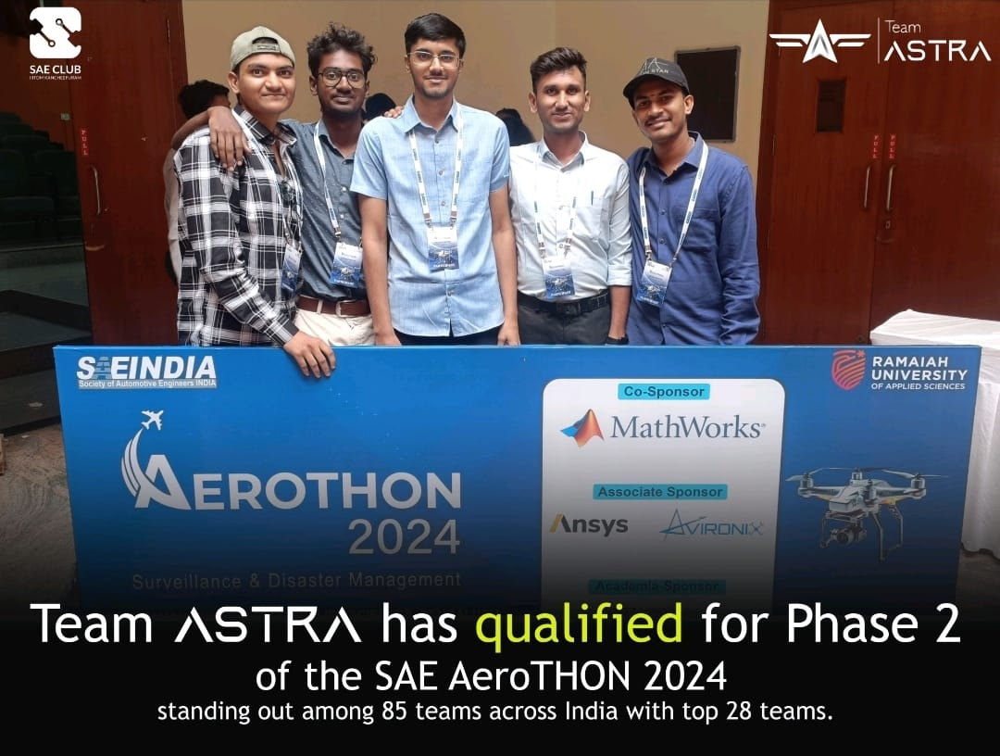
SAE Aerothon 2024 :
Phase 1
Design Report Submission
Secured top 30 position in Phase 1 Design report presentation

Slide 16
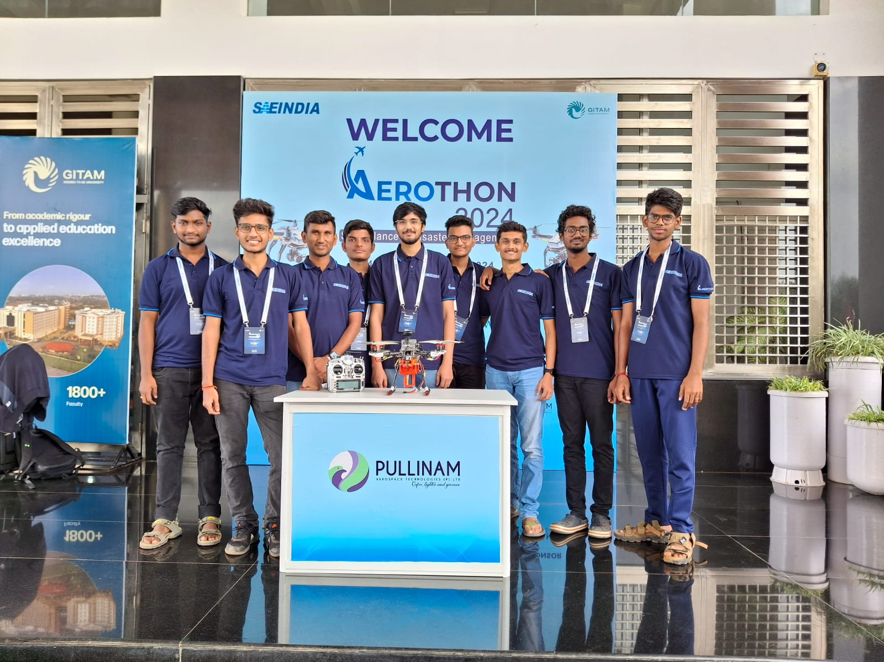
SAE Aerothon 2024: Phase II
14 to 17 November, Bengaluru
Successfully Completed our manual and Autonomous Operation

Slide 17
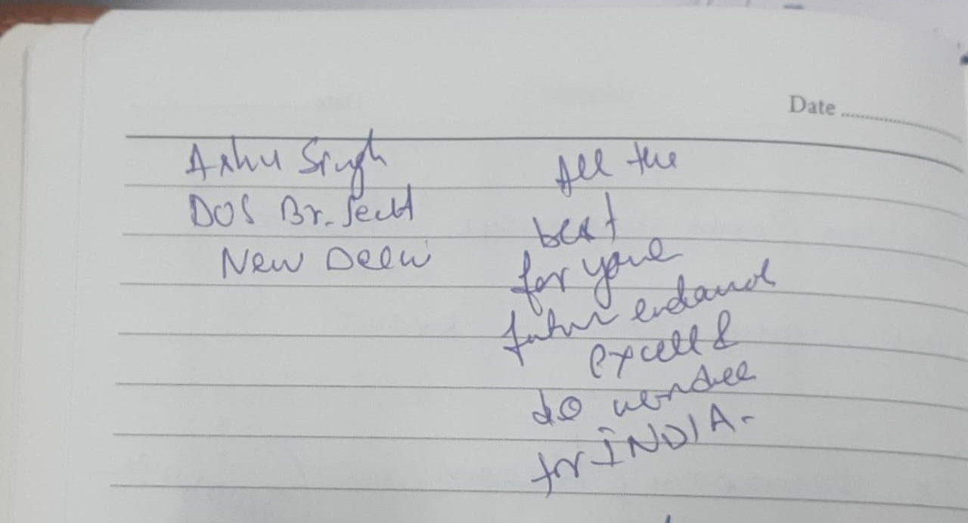
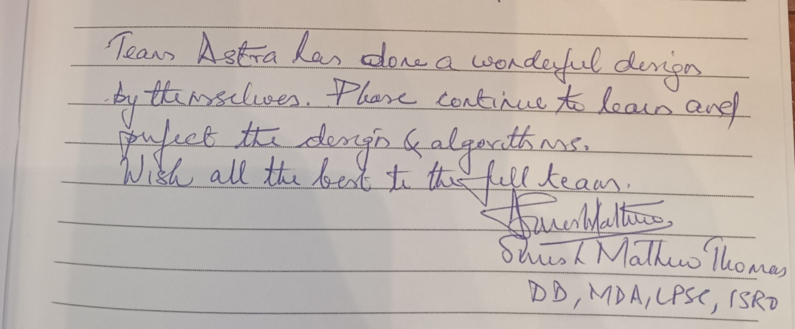
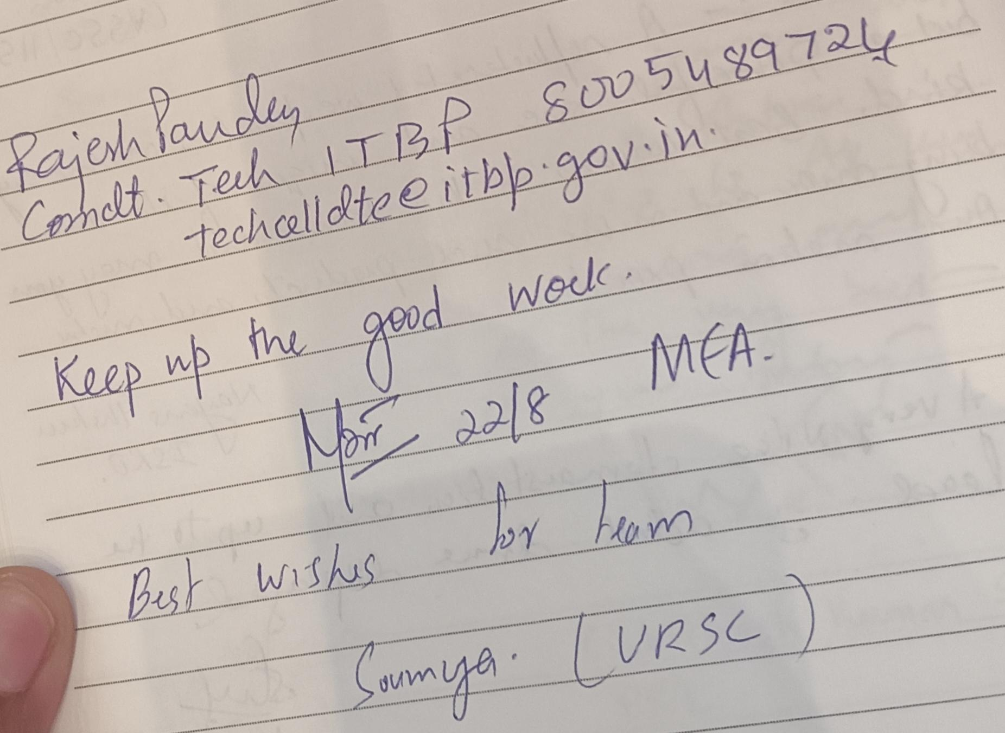
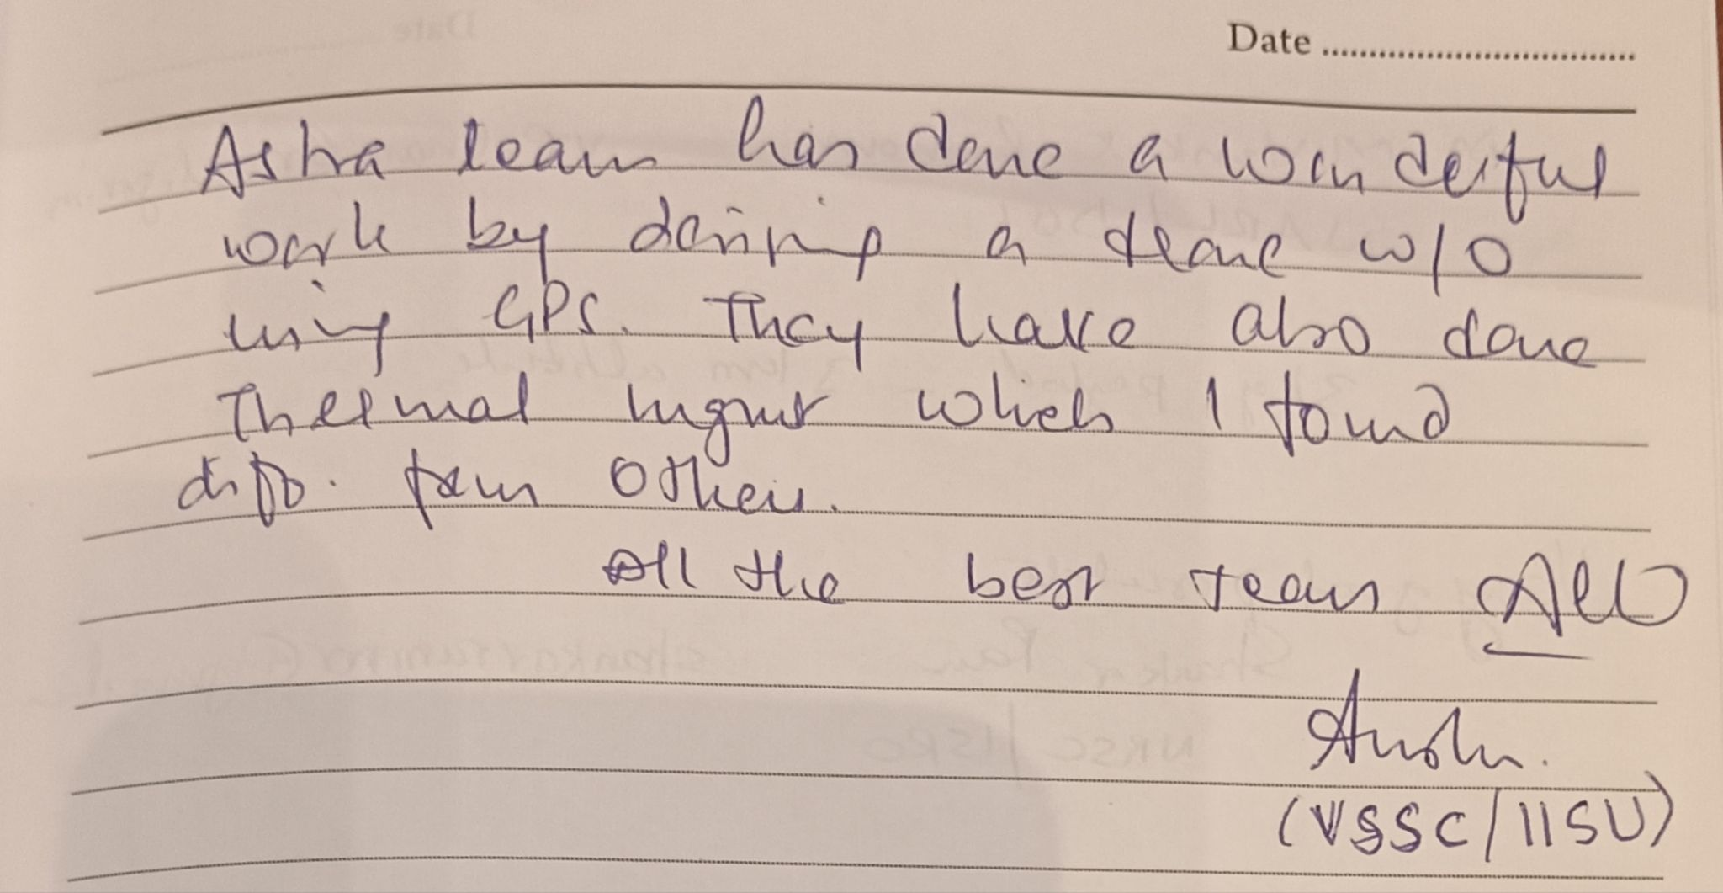
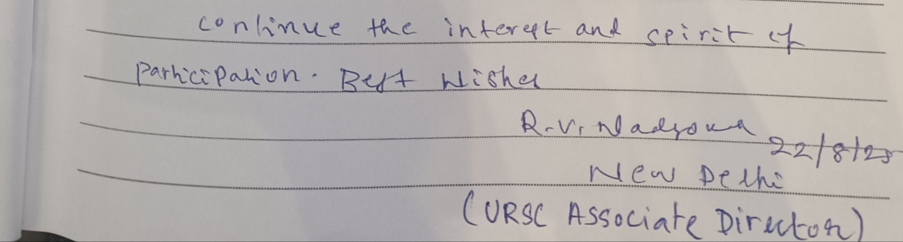
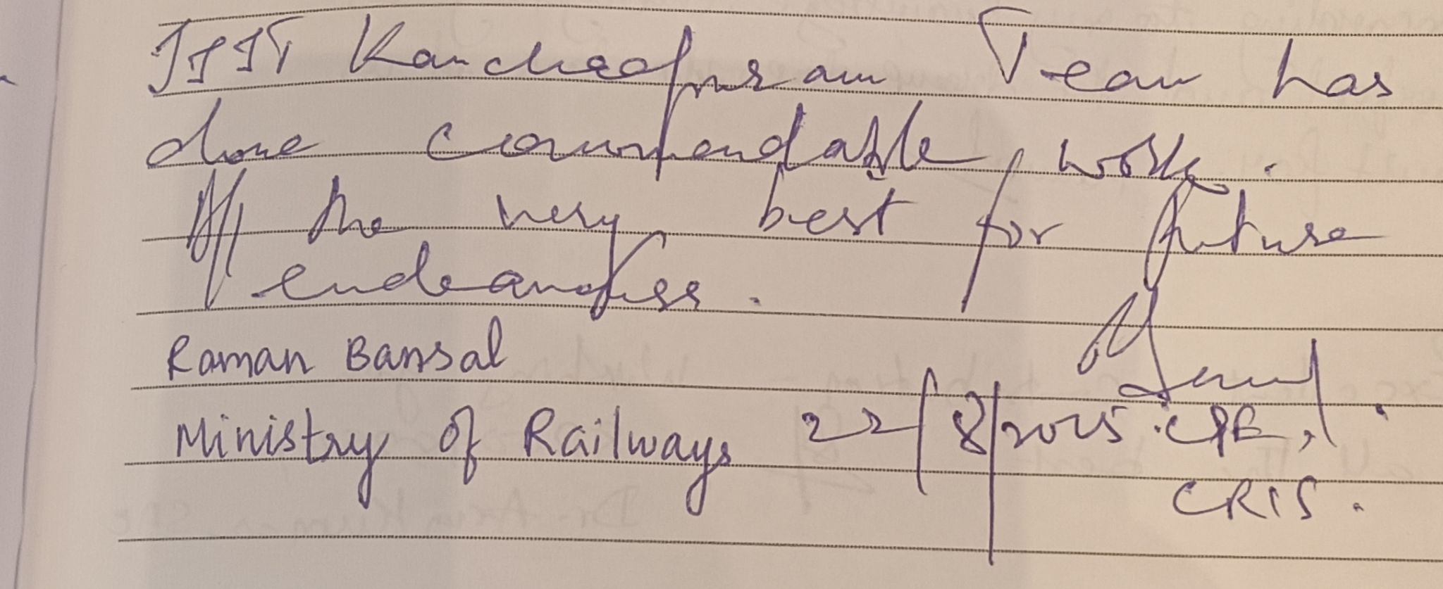
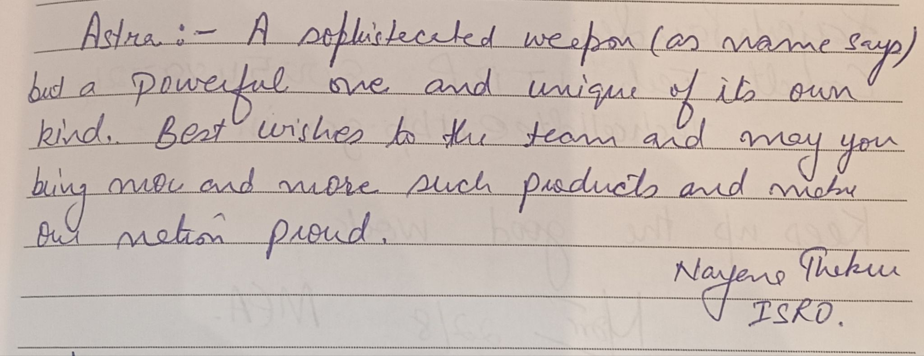
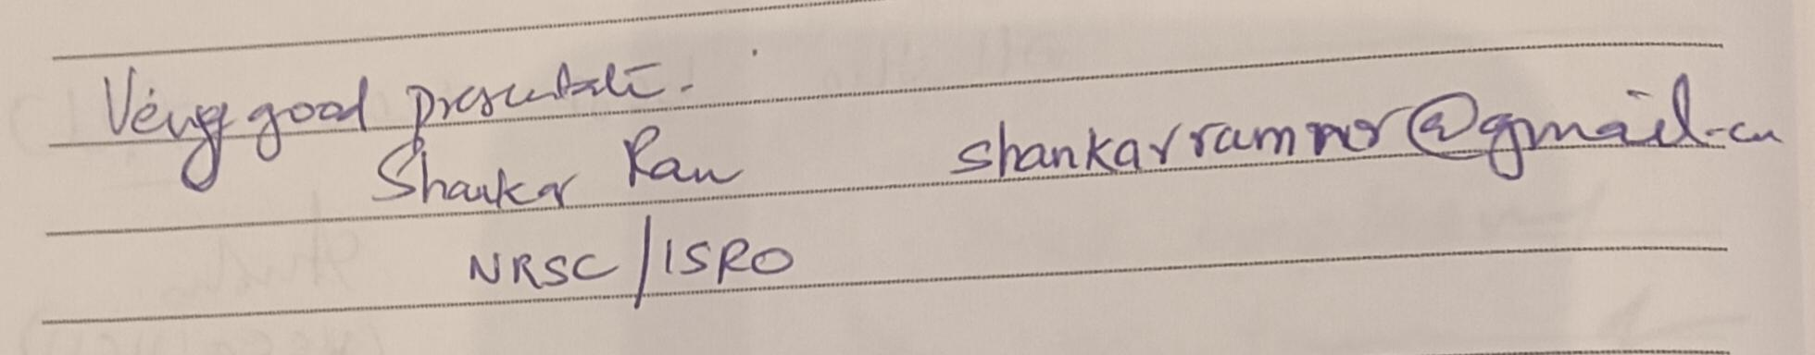
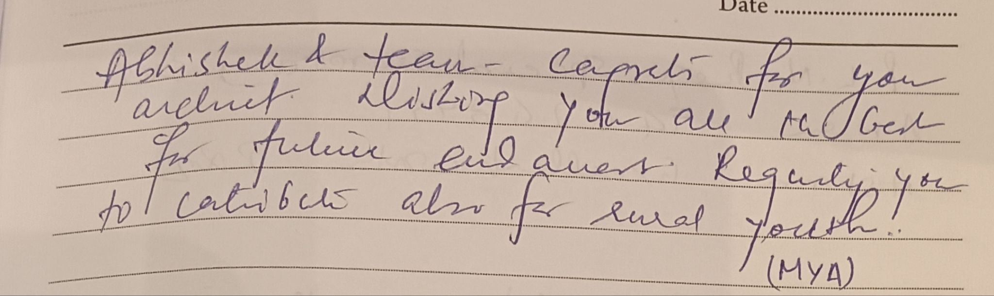
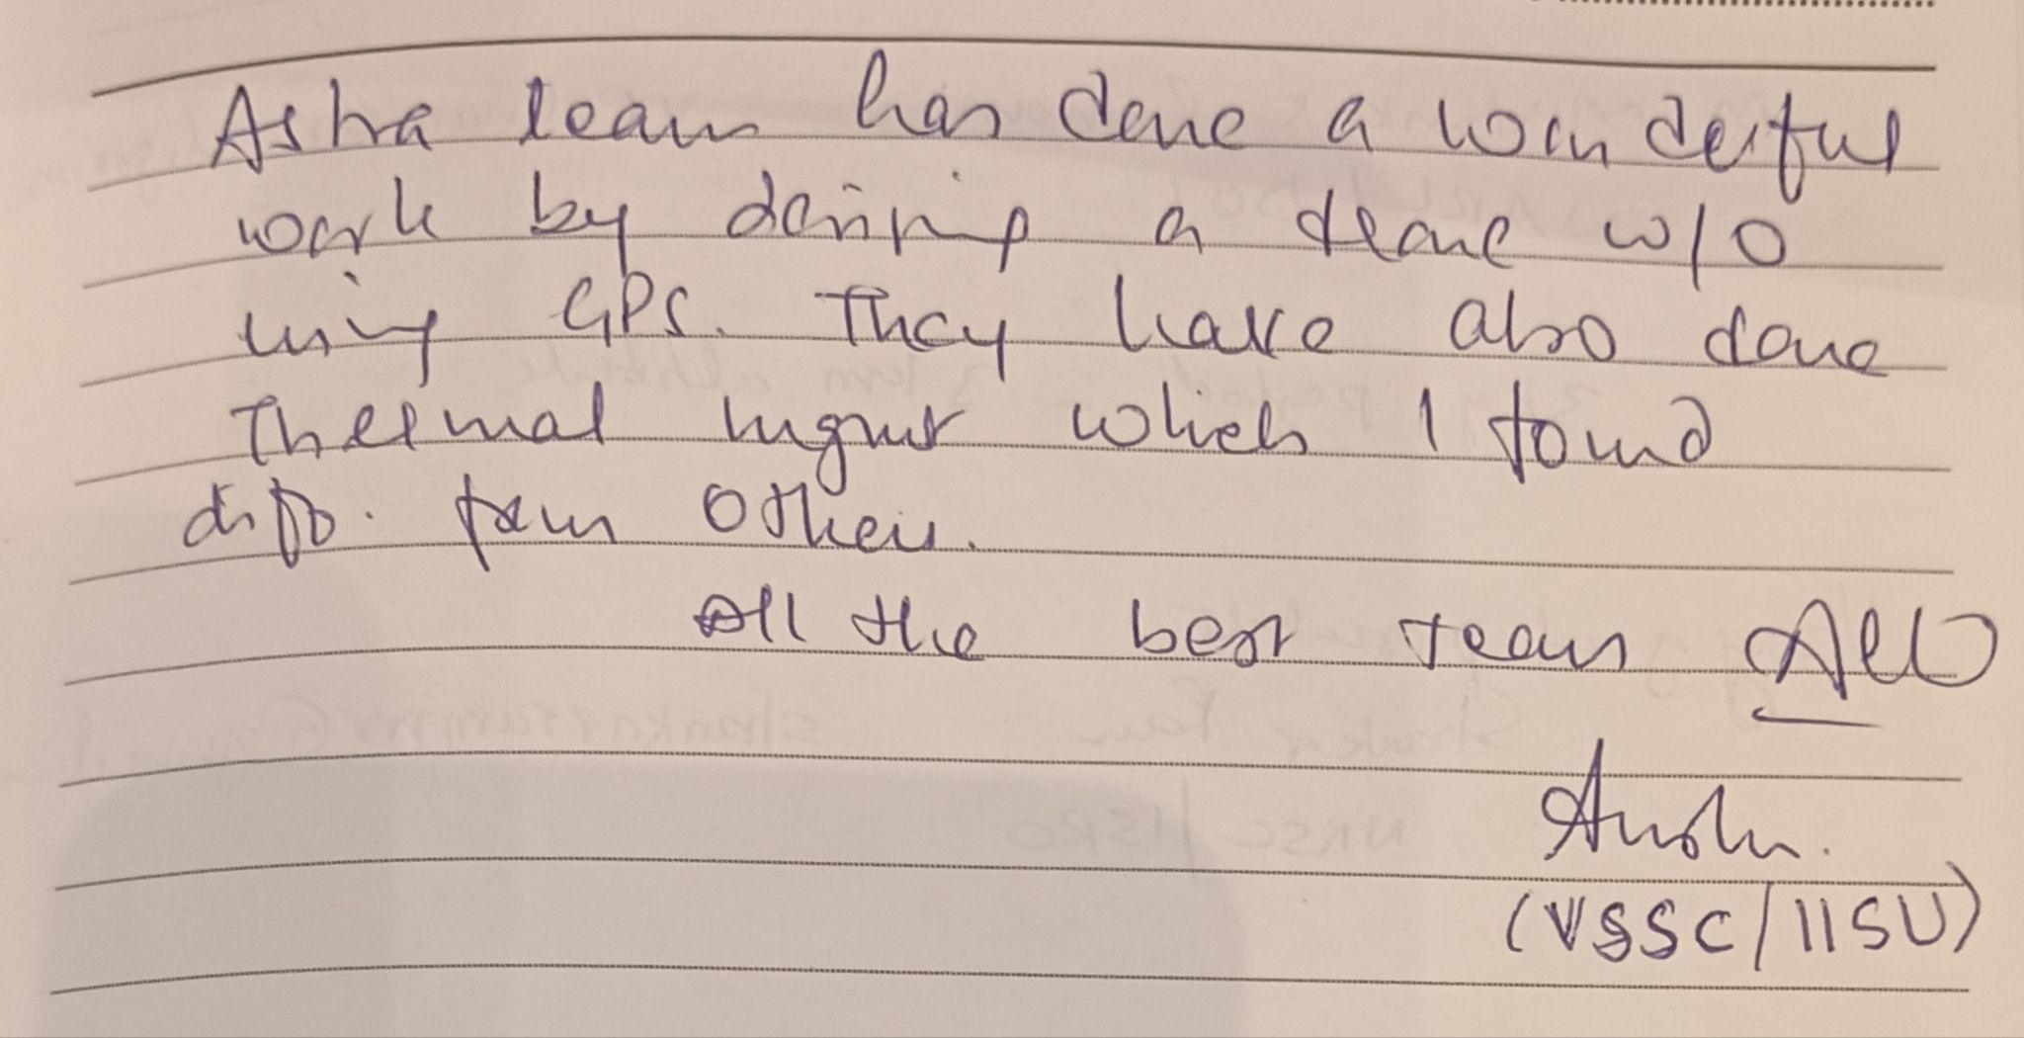
Appreciations

Slide 18


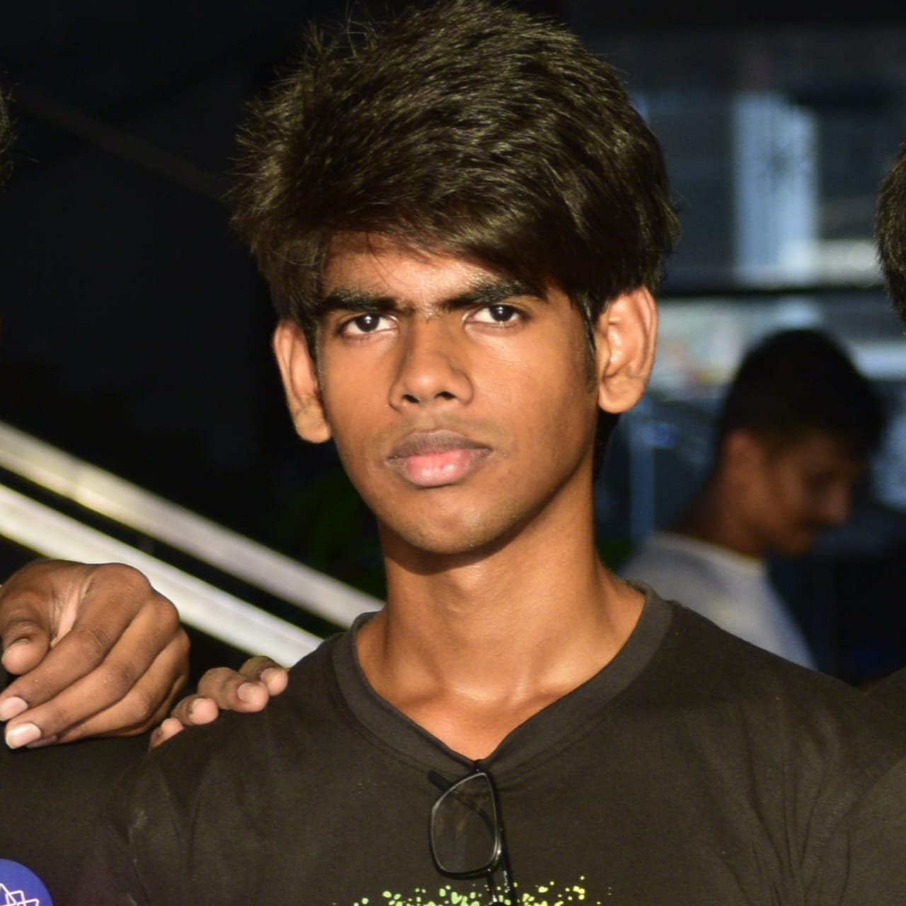
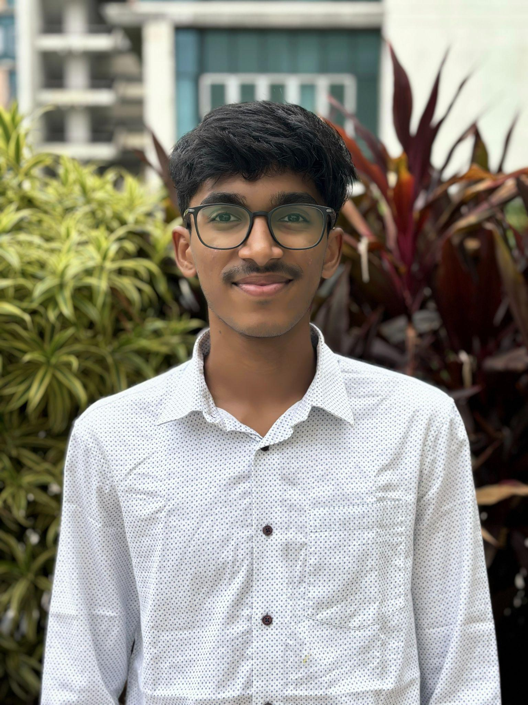
Team HQ
Introduction
Abhishek
Sen
Neshanth
R
Vice-Captain
Vigesh
Manager
Team Captain

Slide 19
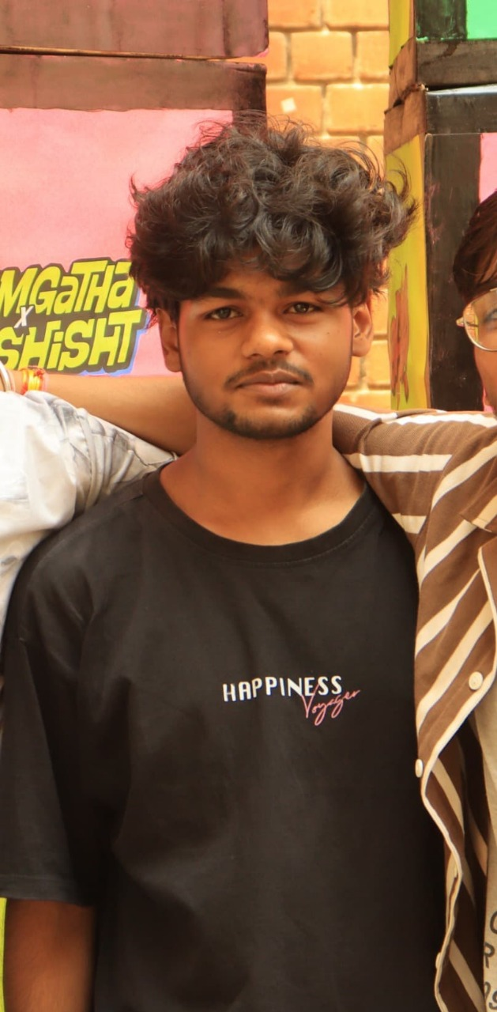
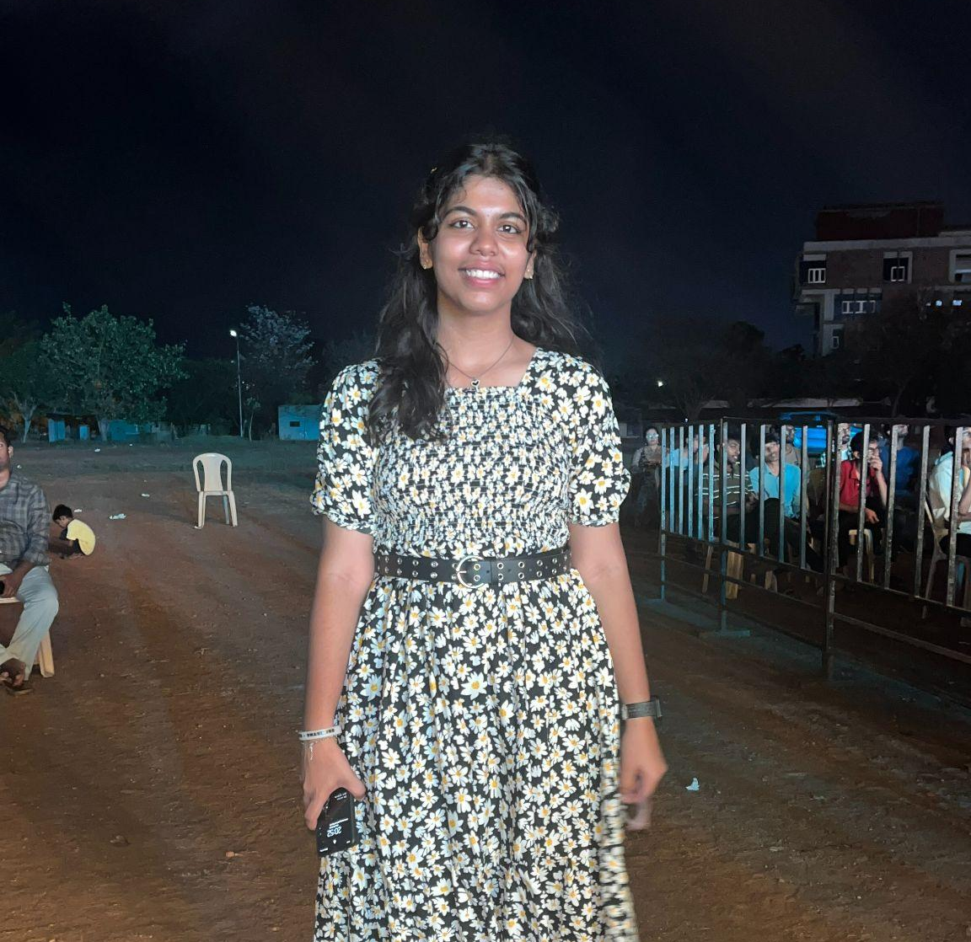
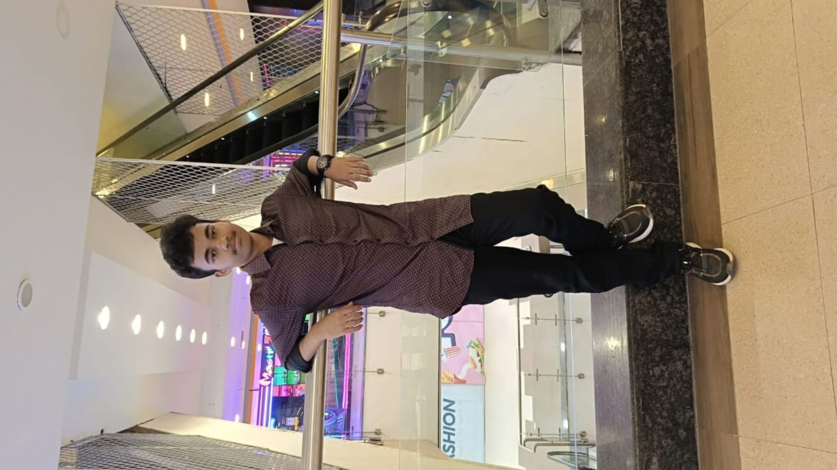
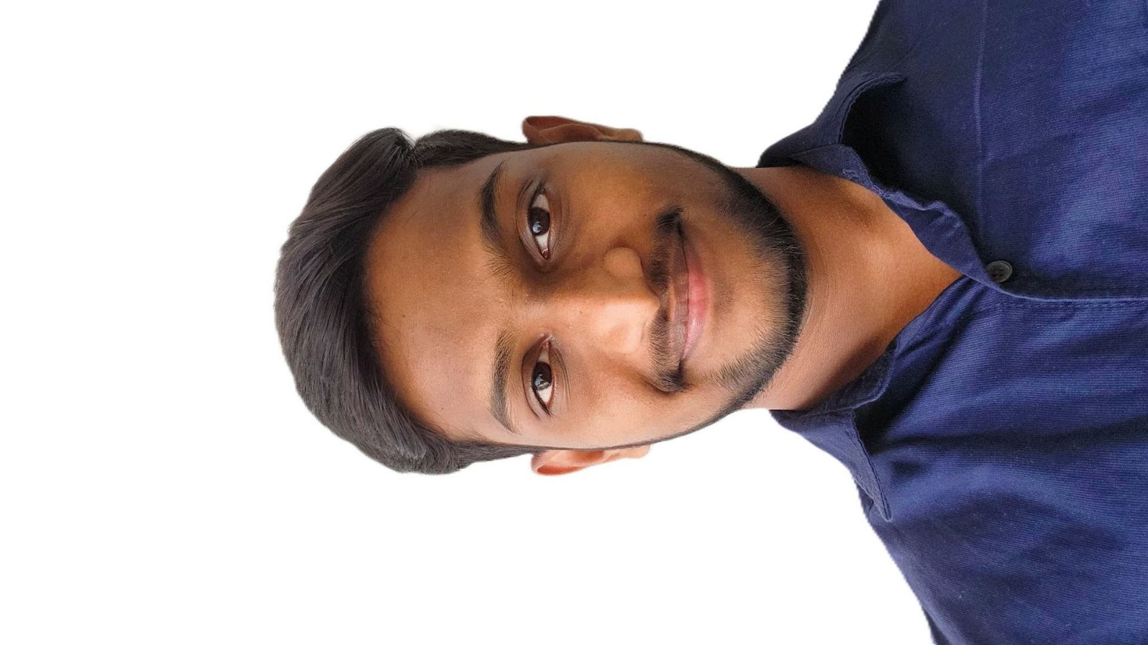
Team Leads
Introduction
Pritha
CS lead
Aerothon 2025
Akash
CS lead
ISRO 2025
Venu
Mech lead
Prajay
ECE lead

Slide 20

Future
To achieve Autonomous flight
Improving payload dropping mechanism.
Optimize the design process
To build a fixed wing autonomous UAV.

Slide 21

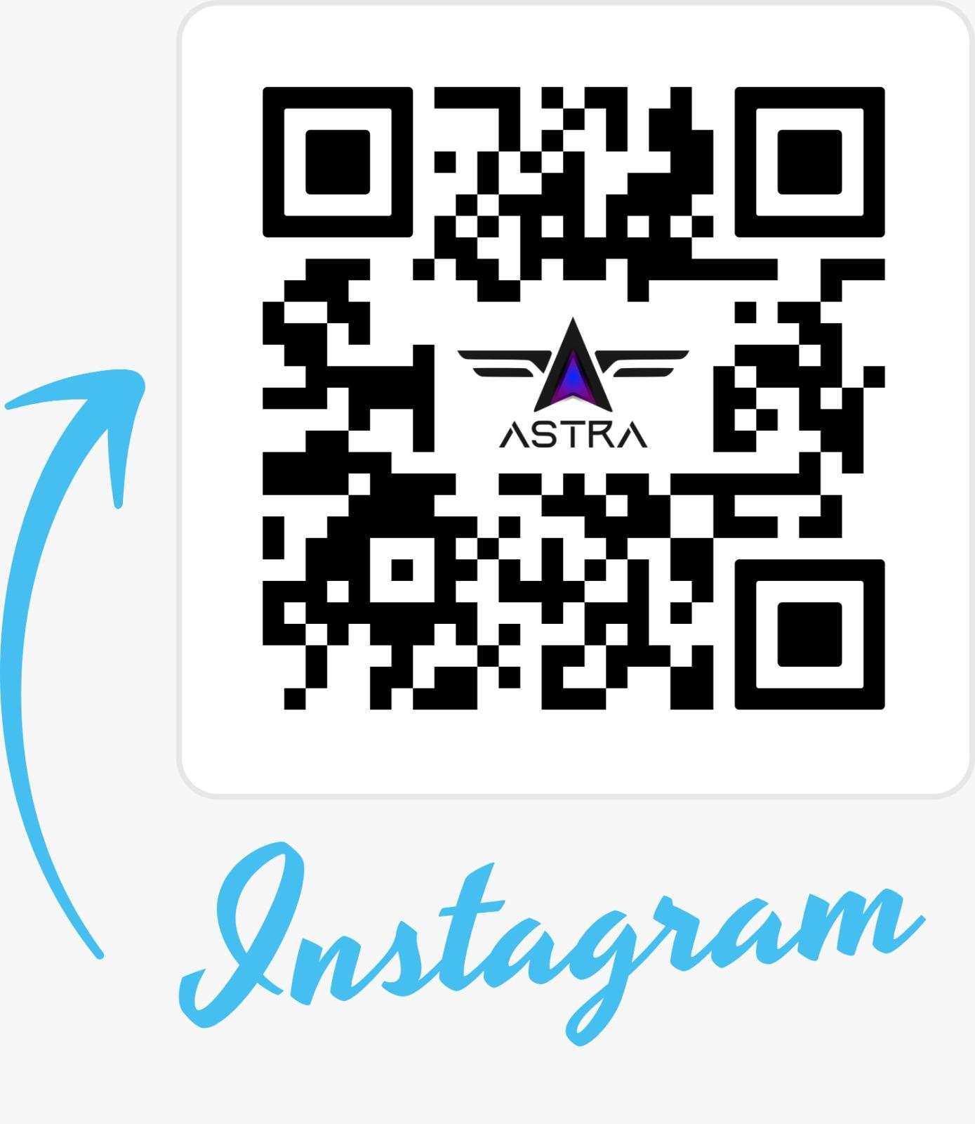

Slide 22
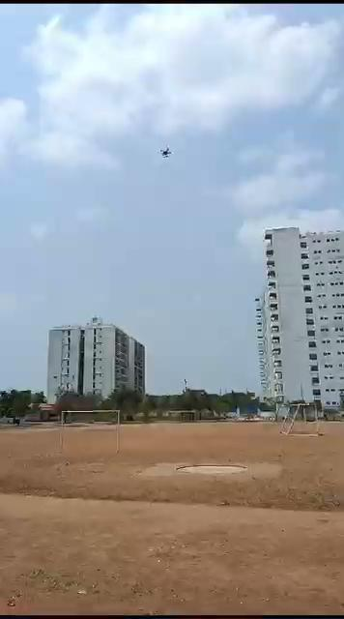
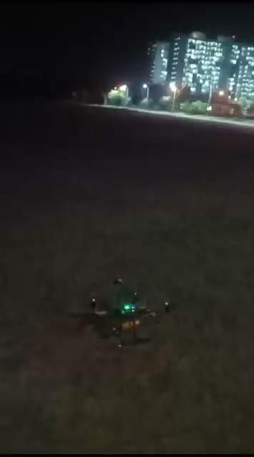
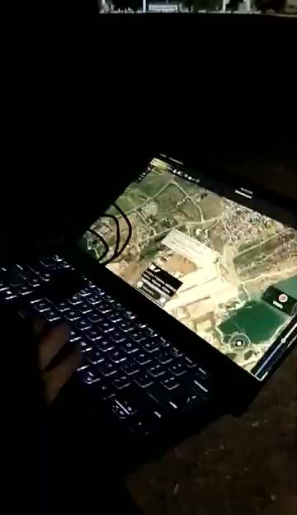
Videos

